Slide 1
GEOG 475 Advanced GIS Lab3
Zhenlei Song, Ph.D Student
Department of Geography
Email: songzl@tamu.edu
Office: CSA 301F

Slide 2
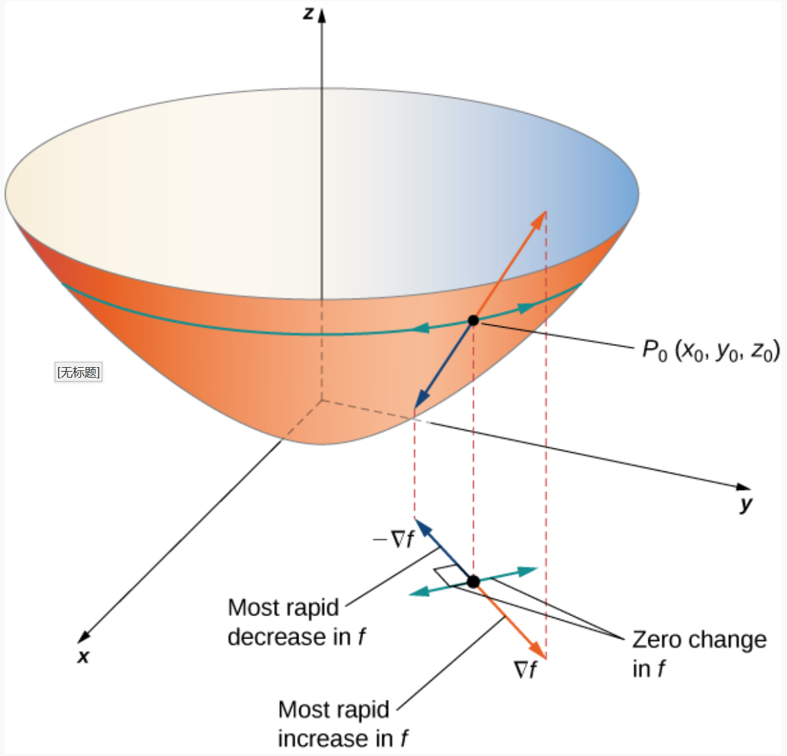
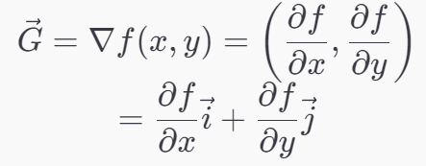
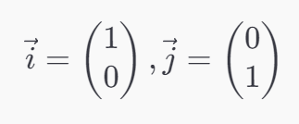
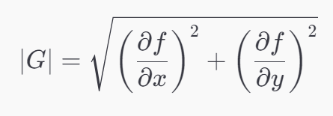
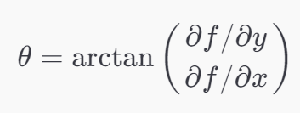
First-Order Derivative- Gradient
Assume a 2-D function f on x,y: f(x,y), its gradient G is defined as:
It’s a vector, its magnitude and direction can be defined as:
The direction can be represented as an angle θ

Slide 3
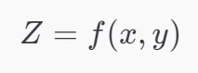
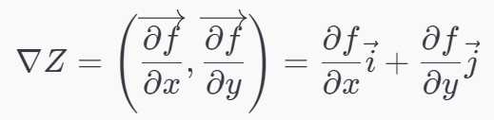
Gradient of DEM
Assume the DEM as a 2-D function Z on x,y
If we apply the gradient operator ∇ on this function, the gradient of the DEM is a vector.
What is the magnitude and direction of the gradient?

Slide 4
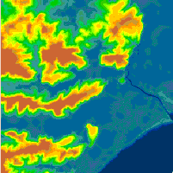
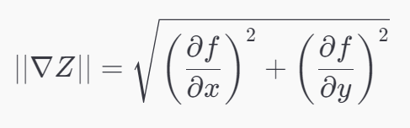
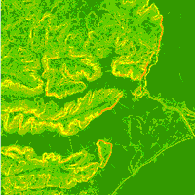
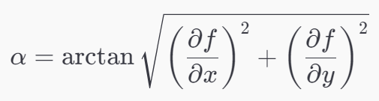
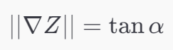
Slope
The gradient of DEM is:
The magnitude of DEM’s gradient is:
Value range of ||∇Z|| is: [0, inf]
So we can use tan of an angle to describe ||∇Z||
Physical meaning of this angle α: the angle between the x-y plane and the tangent plane of the terrain surface.
Notes:
Question:
If the dataset is an array instead of a list of data points. Is the variance a single value or a list of values?

Slide 5
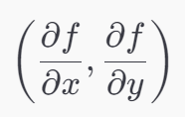
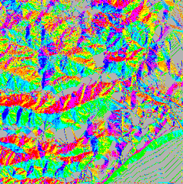
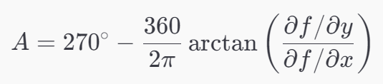
Aspect
The directional vector of ∇Z is:
If we define another angle A (Aspect):
Aspect angle is calculated in degrees dur North.

Slide 6
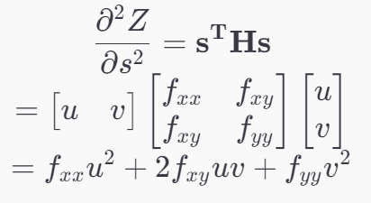
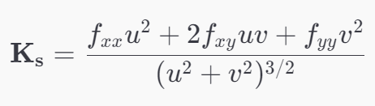
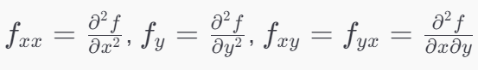
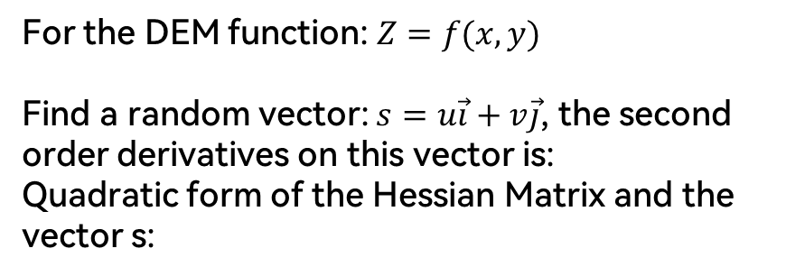
Second-Order Derivative
For the DEM function: $Z=f(x,y)$
Find a random vector: $s=u\vec{i}+v\vec{j}$, the second order derivatives on this vector is:
Quadratic form of the Hessian Matrix and the vector s:
The second-order directional derivative describes how much the function bend along the direction of s in the parameter space instead of reality surface.
Apply
normal vector correction
unit vector normalization
The final curvature:
Convexity is positive curvature and concavity is negative curvature
Notes:
According to different directional vector ss, there are several alternative measures of surface curvature.
The three most frequently provided within GIS software are
profile curvature,
plan curvature
and tangential curvature.
Additional terms and measures include longitudinal curvature, cross-sectional curvature, maximum and minimum curvature, and mean curvature.
A question here: is curvature of this second order dr a vector or a scaler?

Slide 7
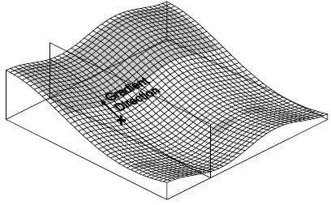
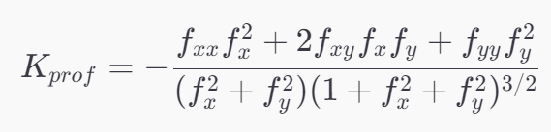
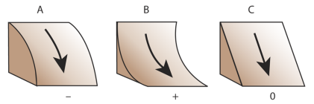
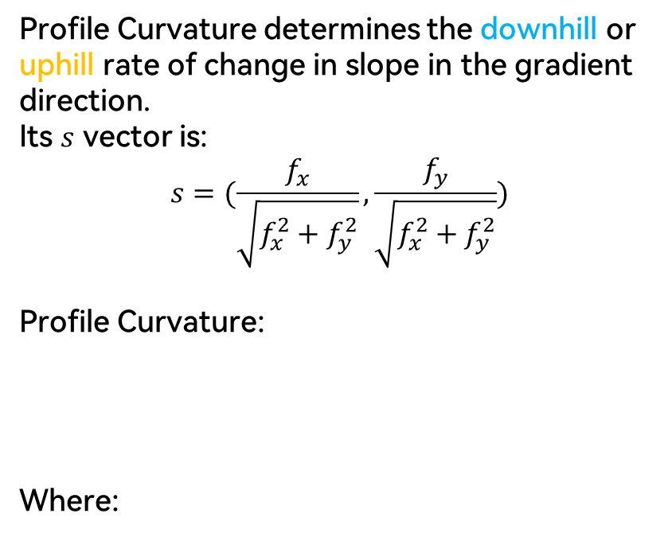
Profile Curvature
Profile Curvature determines the downhill or uphill rate of change in slope in the gradient direction.
Its $s$ vector is:
$$s=(\frac{f_{x}}{\sqrt{f_{x}^{2}+f_{y}^{2}}},\frac{f_{y}}{\sqrt{f_{x}^{2}+f_{y}^{2}}})$$
Profile Curvature:
Where:

Slide 8
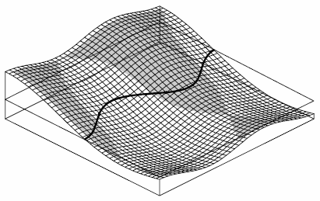
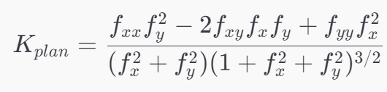
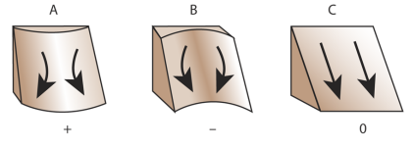
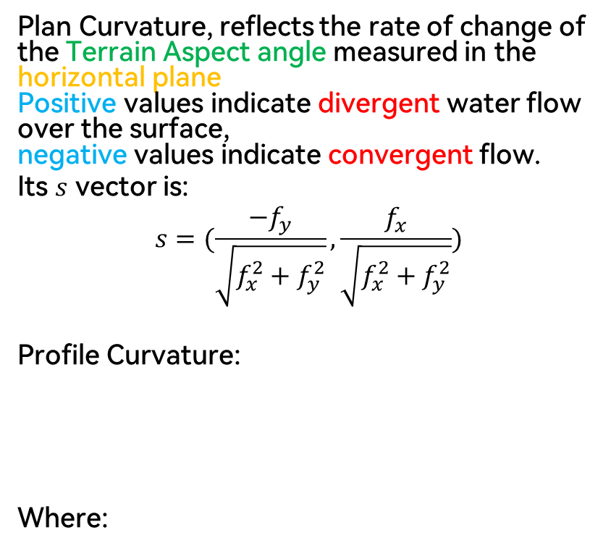
Planform Curvature
Plan Curvature, reflects the rate of change of the Terrain Aspect angle measured in the horizontal plane
Positive values indicate divergent water flow over the surface,
negative values indicate convergent flow.
Its $s$ vector is:
$$s=(\frac{{−f}_{y}}{\sqrt{f_{x}^{2}+f_{y}^{2}}},\frac{f_{x}}{\sqrt{f_{x}^{2}+f_{y}^{2}}})$$
Profile Curvature:
Where:

Slide 9
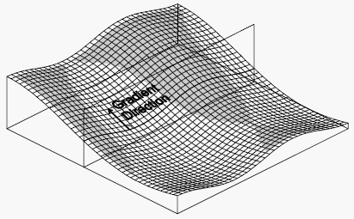
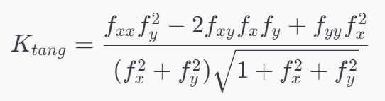
Tangential Curvature
Tangential Curvature, measures curvature in relation to a vertical plane perpendicular to the gradient direction.
The negative and positive areas are the same as for Plan Curvature, but the curvature values are different.
Profile Curvature:
Where:

Slide 10
PART 1
Univariate Statistics

Slide 11
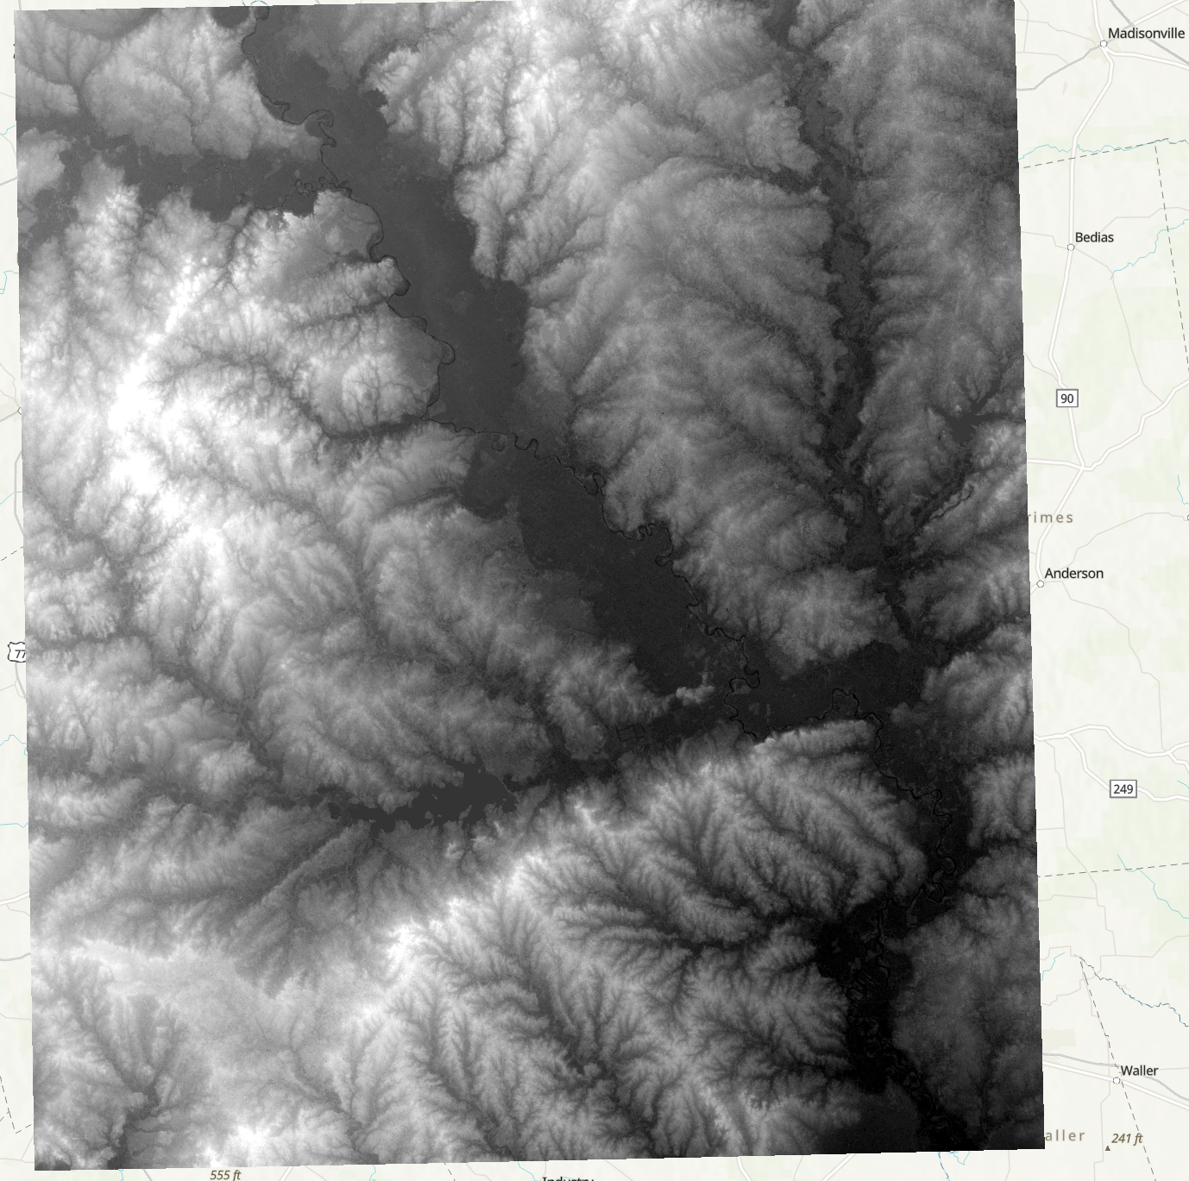
Source Data – DEM

Slide 12
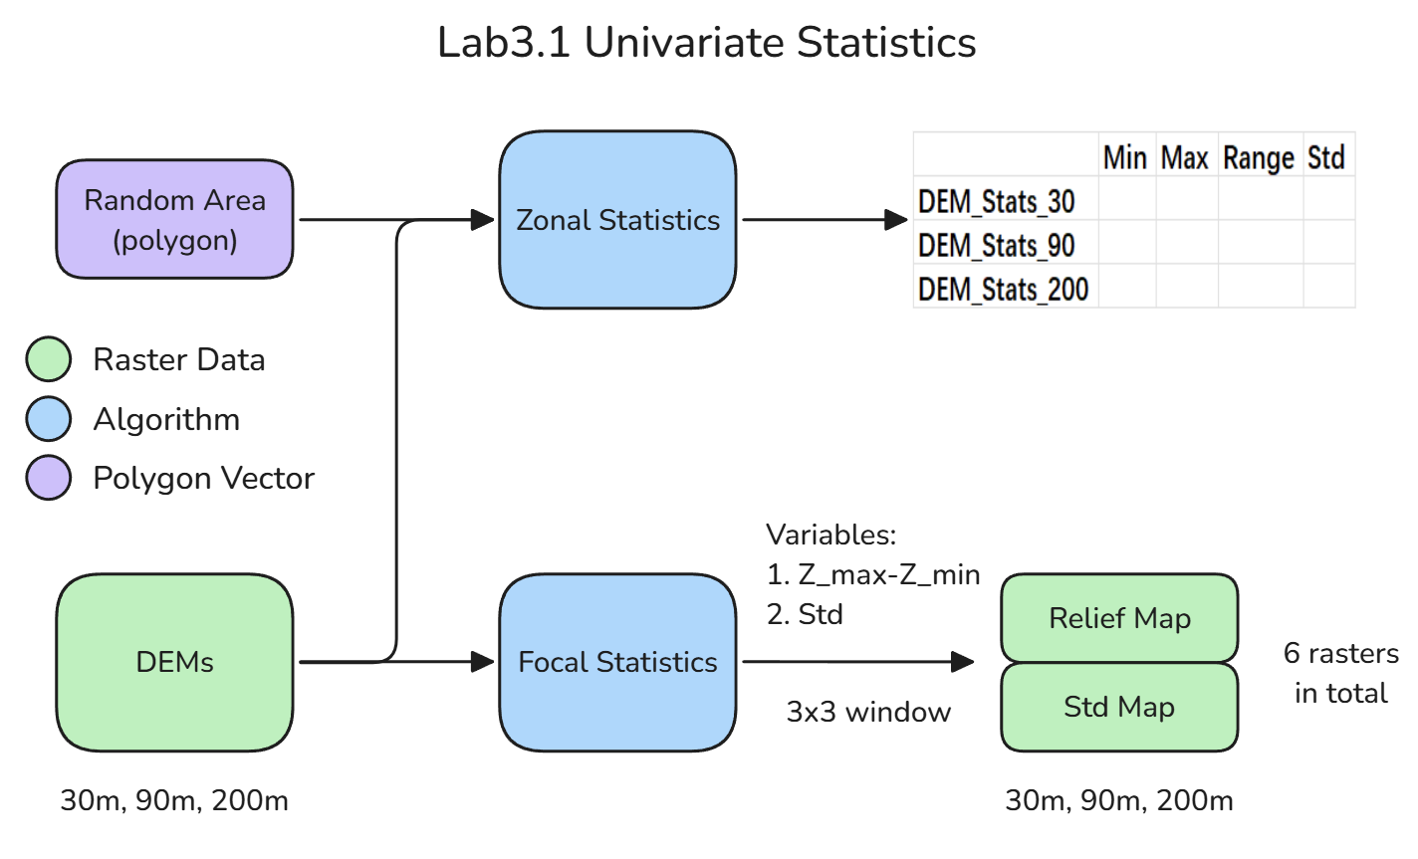
Part 1

Slide 13
Part 1. Expected Results

Slide 14
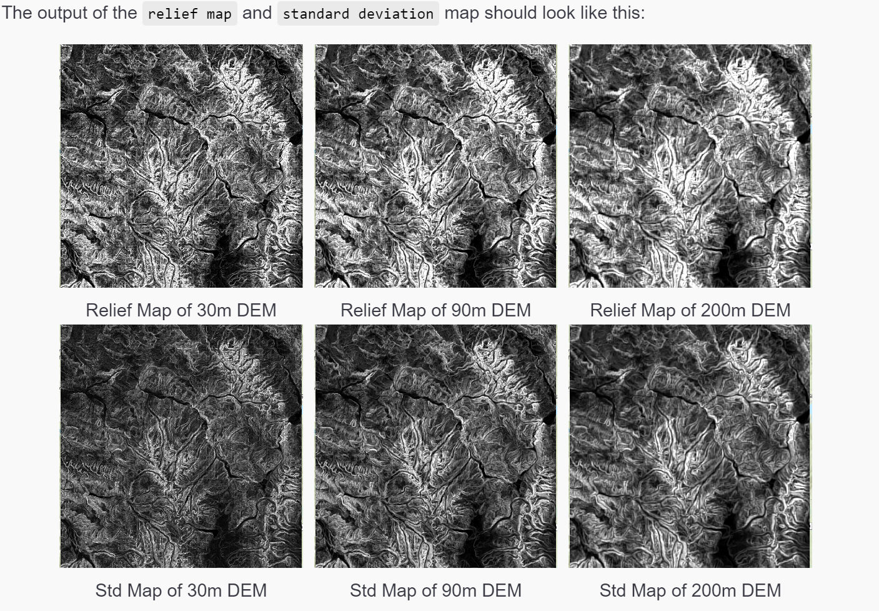
Part 1. Expected Results

Slide 15
Part1.Tasks
Load the DEM raster layers (30m, 90m, 200m from Lab1).
Apply focal stats on the DEM using a 3x3 window. Get `range` (max - min) and `std` analysis on these rasters.
Draw a random polygon in the raster’s extent.
Apply zonal stats (min, max, range, std)on the rasters and the polygon.
Concat all the results into a table.

Slide 16
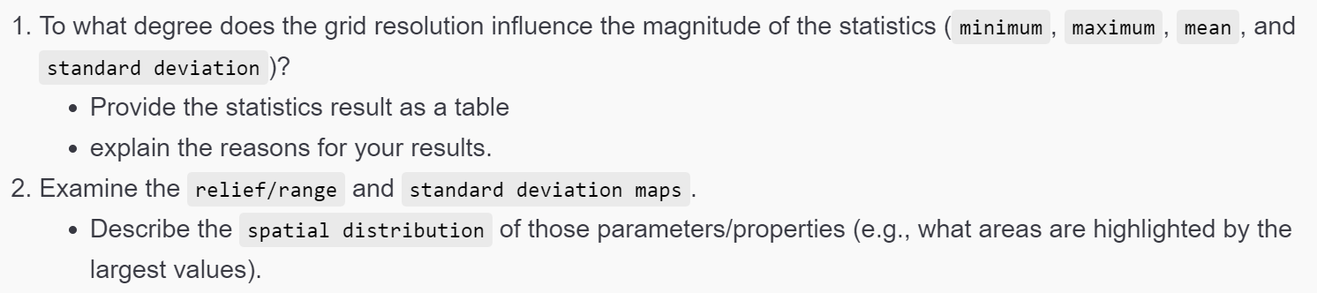
Part1.Expr Questions

Slide 17
PART 2
First Derivatives
Gradients

Slide 18
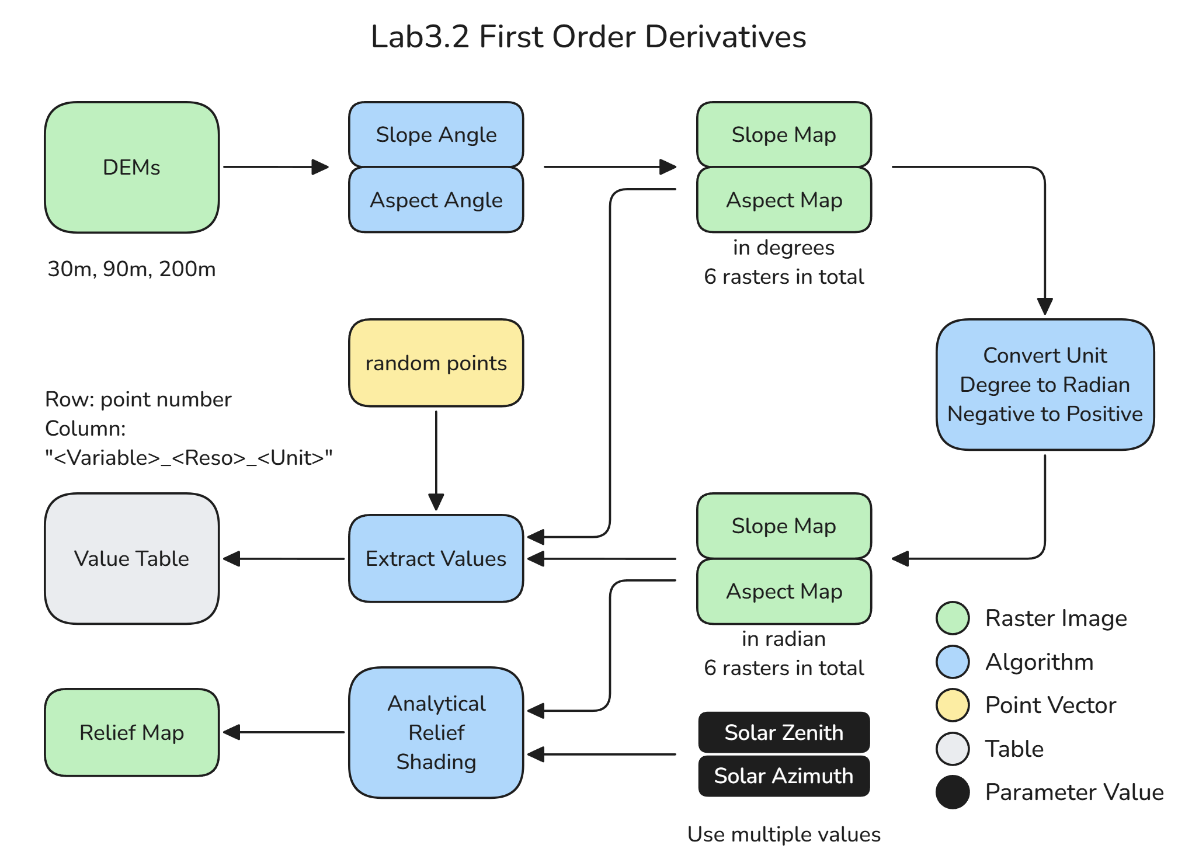
Part 2

Slide 19
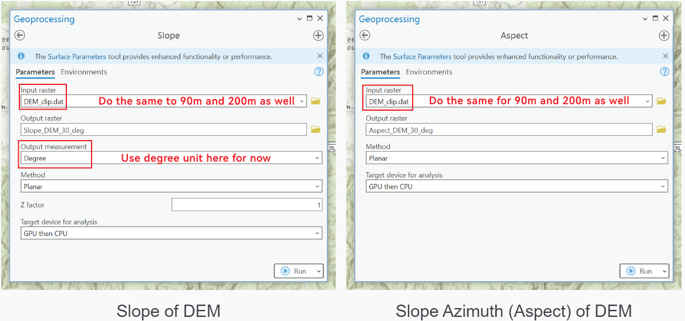
Part 2. Slope & Aspect

Slide 20
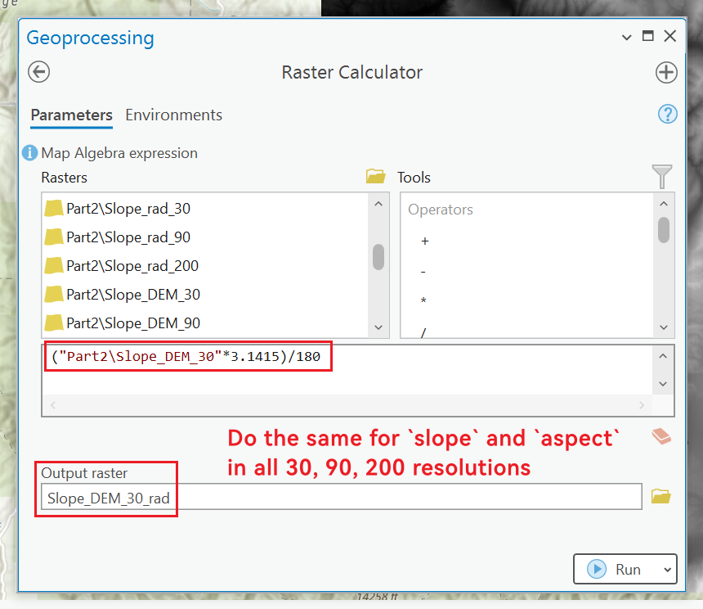
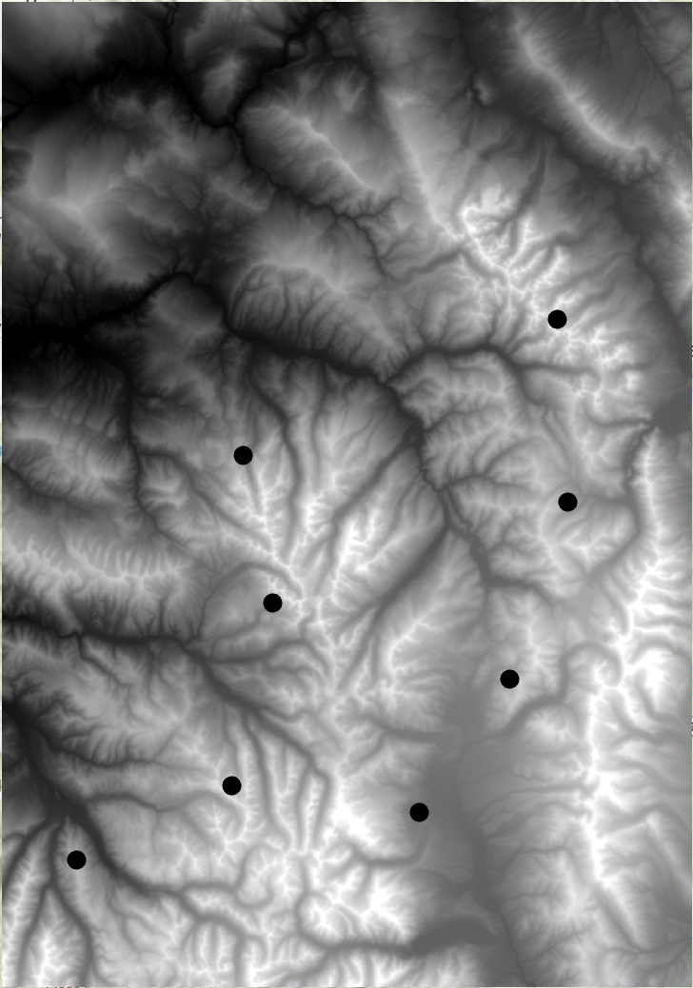
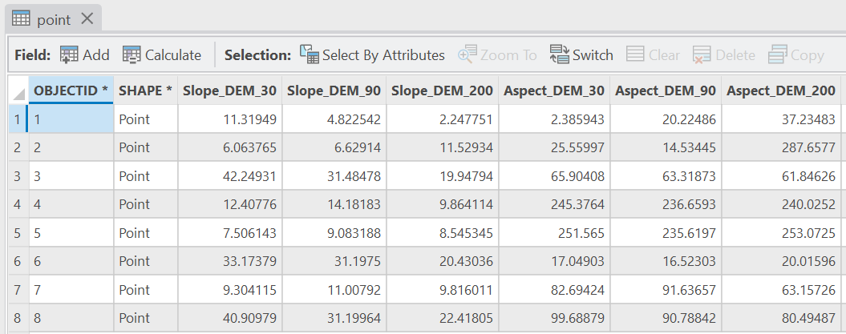
Part 2. Slope & Aspect
Extract values into a table
Randomly select a few points to extract `slope angles` & `slope-azimuth angles` values to points
Each row represents a point, each column is `slope` or `aspect` under certain resolution
Notes:
Till here all values are in degrees.

Slide 21
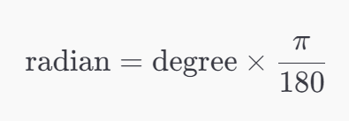
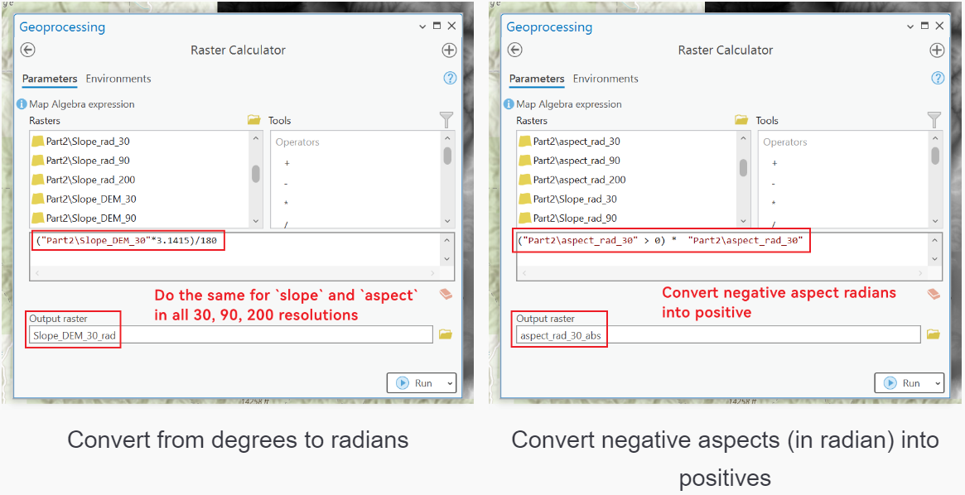
Part 2. Relief-Shade
Convert all DEGREE to RADIAN !!!
Convert negative to positive values!!!
Notes:
Make sure you extract the positive values in radian into the table again.

Slide 22
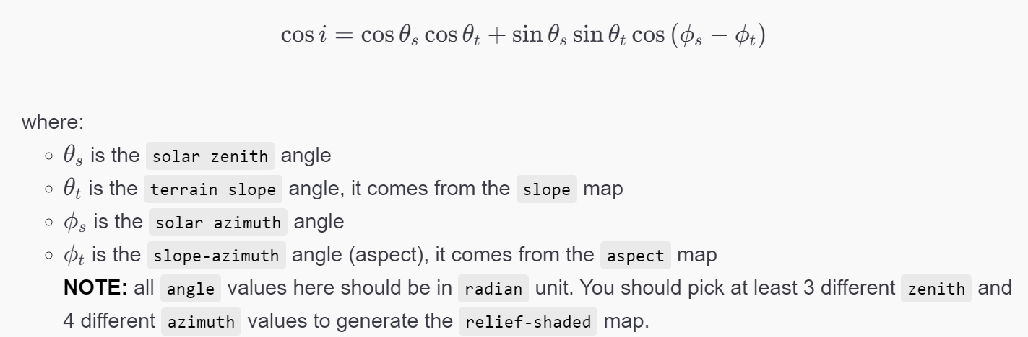
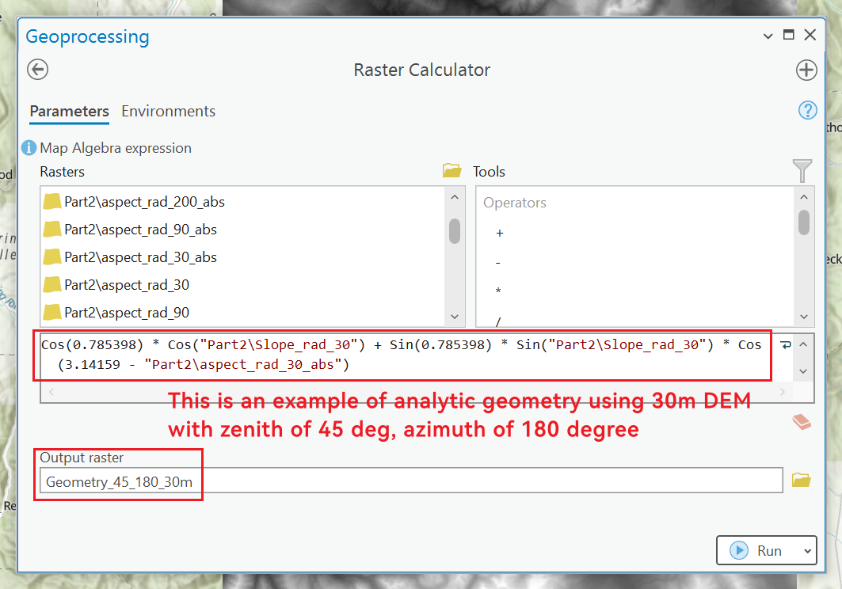
Part 2. Relief-Shade
Calculate your own Relief-Shade Map
Notes:
This is an example of using 45 as solar zenith and 180 as solar azimuth.
The terrain zenith and terrain azimuth come from last step.
Try multiple combinations of solar zenith and azimuth here!!!

Slide 23
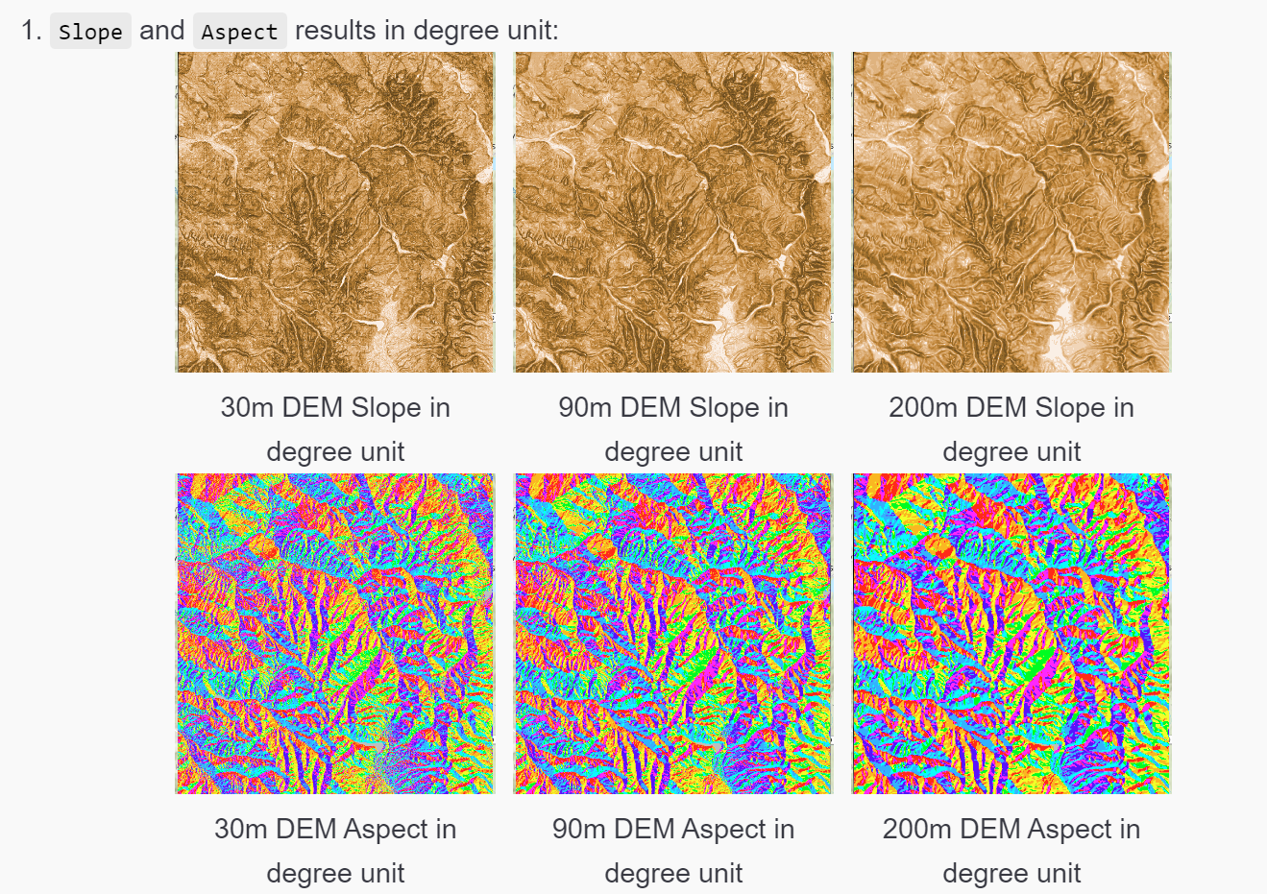
Part 2. Expected Results

Slide 24
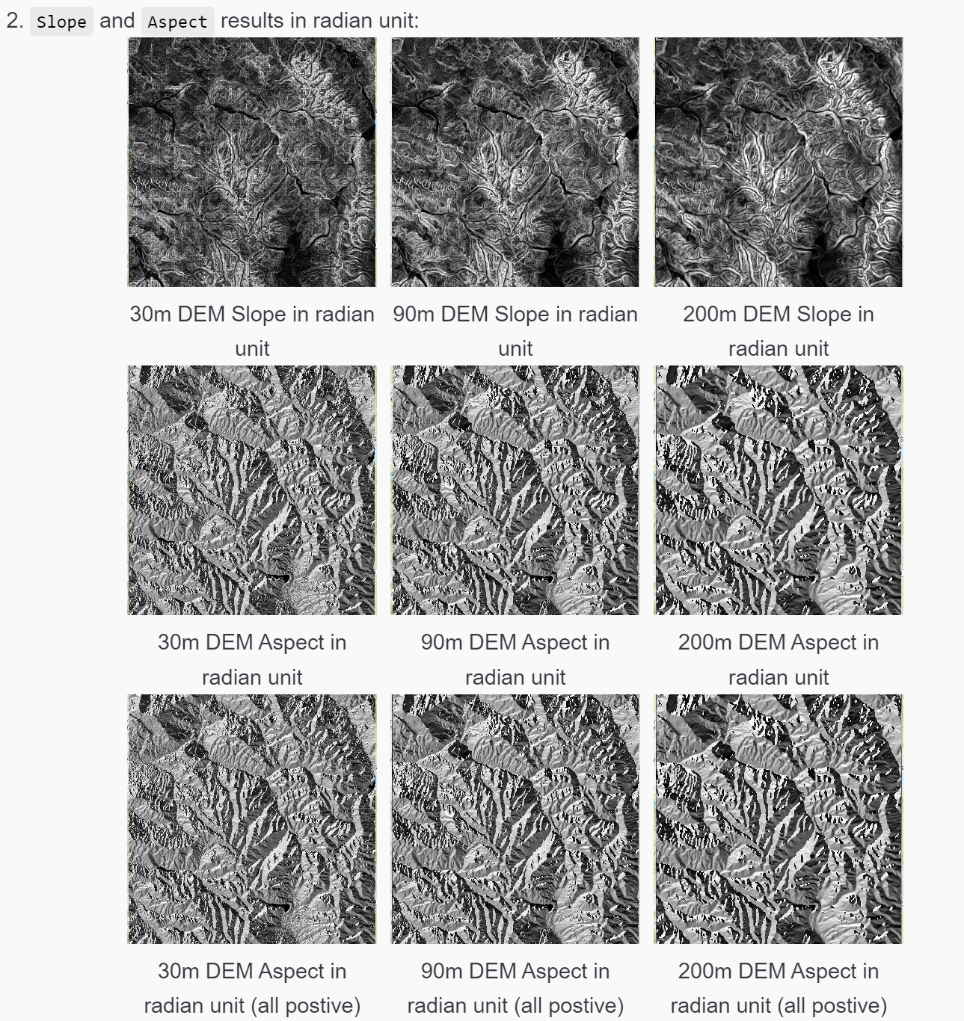
Part 2. Expected Results

Slide 25
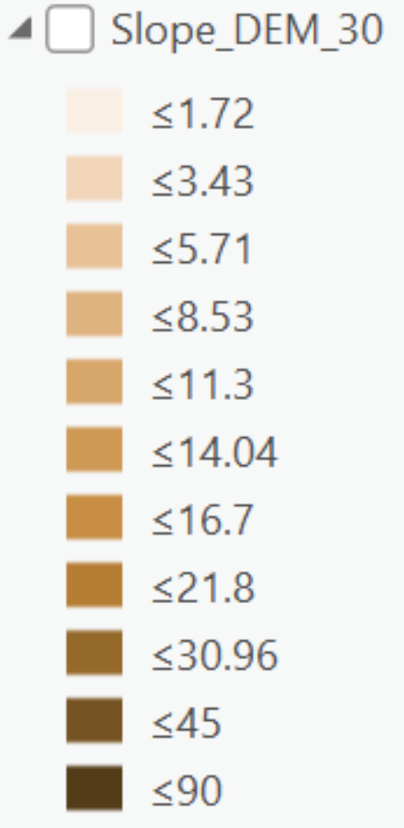
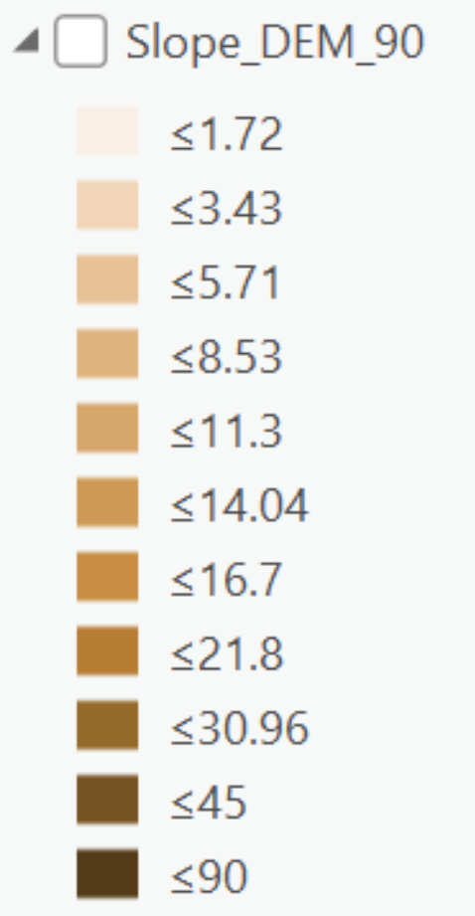
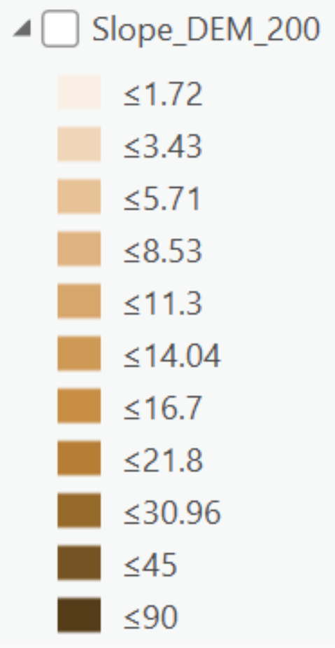
Part 2. Expected Results

Slide 26
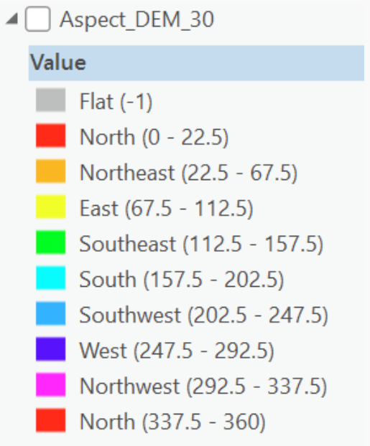
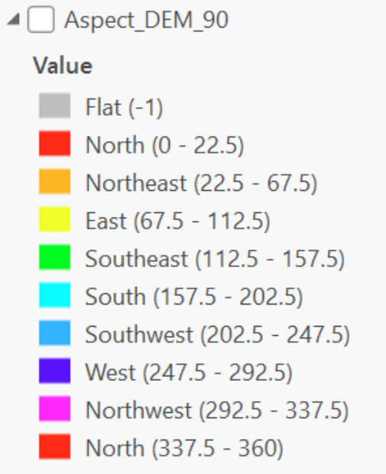
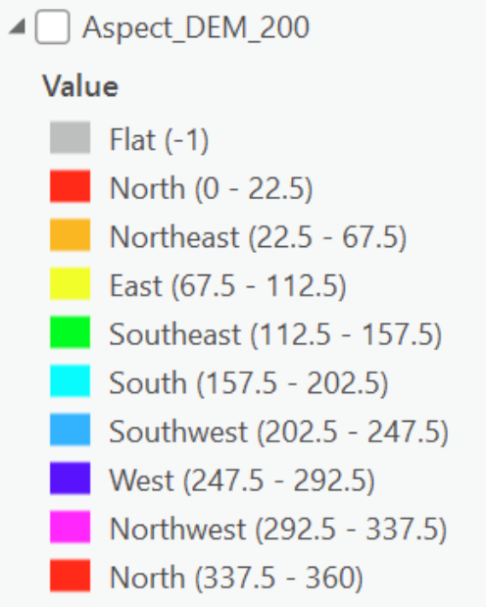
Part 2. Expected Results

Slide 27



Part 2. Expected Results

Slide 28


Part 2. Expected Results

Slide 29
Part2.Tasks
Load DEMs in 3 resolutions
Calculate `slope` and `aspect` angles output rasters in degrees.
Convert all values into radians, convert all negative values into positives.
Draw a few random points, extract ALL values into a table.
Calculate your own relief-shaded map using the given equation.

Slide 30

Part2.Expr Questions

Slide 31
PART 3
Second-Order Derivatives
Curvature

Slide 32

Part 3

Slide 33

Part 3. Curvature

Slide 34
Part3.Tasks
Load the DEM dataset
Produce the Profile and Tangential curvatures
Examine the spatial distribution of curvature over the landscape
Don’t trust ArcGIS produced curvature values’ sign. Examine yourself.

Slide 35

Part 3 Expected Results

Slide 36

Part3. Expr Questions

Slide 37
Submission
A .doc/docx file includes:
Contexts and necessary screenshots (with captions) to prove you completed all required steps.
Comparisons of performances with different algorithms and parameter settings. Describe what changes did you make and what’s changed.
Answer the designated questions with YOUR OWN interpretation.

Slide 38

Grading Rule

Slide 39
The End

